Slide 1
Inspiring, Equipping and Supporting GPs in Leadership:
Towards a bright future for primary care
Name
Faculty of Medical Leadership and Management, GP Champion
Event
Date
Venue
Email address
@......twitter handle
Notes:
.

Slide 2

What do we mean by “leadership?”
“Enabling yourself and others to flourish”:
Using your personal and collective influence for the benefit of the population served
Teamwork
Facilitating improvement
All career stages
All aspects of doctoring – formal and informal leadership roles
It’s a journey!
Notes:
Perhaps start by asking the audience what they think leadership means?
After hearing from them: This is what FMLM means by leadership – it is part of the day job and includes informal as well as formal/positional roles with fancy titles
The final point relates both to the fact that we are all on a journey with leadership - it never ends; and also that leadership can simply be seen as personal development – growing the capability and confidence to be your best self, tackling challenges and realising opportunities proactively throughout your career.

Slide 3
About FMLM
Medical leadership must move from an “amateur sport” to a professional discipline
Professor Peter Lees
Established in 2011 by all of the UK medical royal colleges and faculties
The professional home for medical leadership – UK wide
Strengthening medical leadership for the benefit of the population served
Enabling doctors at all career stages in the leadership and managerial aspects of their professional lives
Ensuring medical leadership is underpinned by evidence linking leadership and team-working with improved patient outcomes
We have defined the leadership and management standards for medical professionals and provide certification for our members to become fellows by demonstrating values, behaviours , competency and experience in line with our standards
“The medical profession is making its contribution with the establishment of the Faculty of Medical Leadership”
Robert Francis
Inspiring, Equipping and Supporting individuals, teams, organisations and systems
Notes:
This outlines what FMLM is here to do and key facts about the organisation and what it does
The bottom quote from Robert Francis is from his report following the Francis Inquiry ( 2013) into Mid Staffs NHS Foundation Trust– he recognised that medical leadership was one of the problems, it needed to be stronger and that an organisation should be established to enable this.
The top quote outlines FMLM’s mission to professionalise medical leadership for the benefit of the population served – Peter being our CEO and Medical Director.

Slide 4
FMLM’s offer to GPs
Inspire
GP career development pathways and framework
Case studies & role models
Events
Online resources
Equip
  Online resources
  Webinars
  FMLM 360 feedback tool
  Leadership development programmes
Support
Peer support network
Career development services
Mentoring and coaching
Certification
Notes:
This is work in progress - gives a flavour of what FMLM offers members
This diagram outlines the benefits of membership

Slide 5
Example of our approach delivering leadership development for a cohort of GPs at varying career stages within an English Clinical Commissioning Group
Testimonials: How did you and your CCG benefit?
‘Nuggets that could change your life!’
‘Overview of the NHS, CCG and where I sit within it all. How to get things done’
‘I have taken on a leadership role and plan to develop this part of my career further’
‘More self awareness to help me lead. greater understanding of leading with conflicting agenda’
‘Empowered!’
Notes:
In addition through FMLM solutions ( our consultancy arm) we offer leadership development programmes to teams, organisations and systems

Slide 6
FMLM Peer Network:
Values & Benefits
connections
opportunities
Shared purpose
Trust & Respect
Inclusivity
Resources
Dialogue
Facilitation
Reciprocity
Challenge
Excellence
Innovation
Encouragement
Advocacy
Recognition
kinship
inspiration
Notes:
Values within arrows and stars outline key benefits – FMLM offers a professional home for the managerial / leadership aspects of our work as doctors

Slide 7
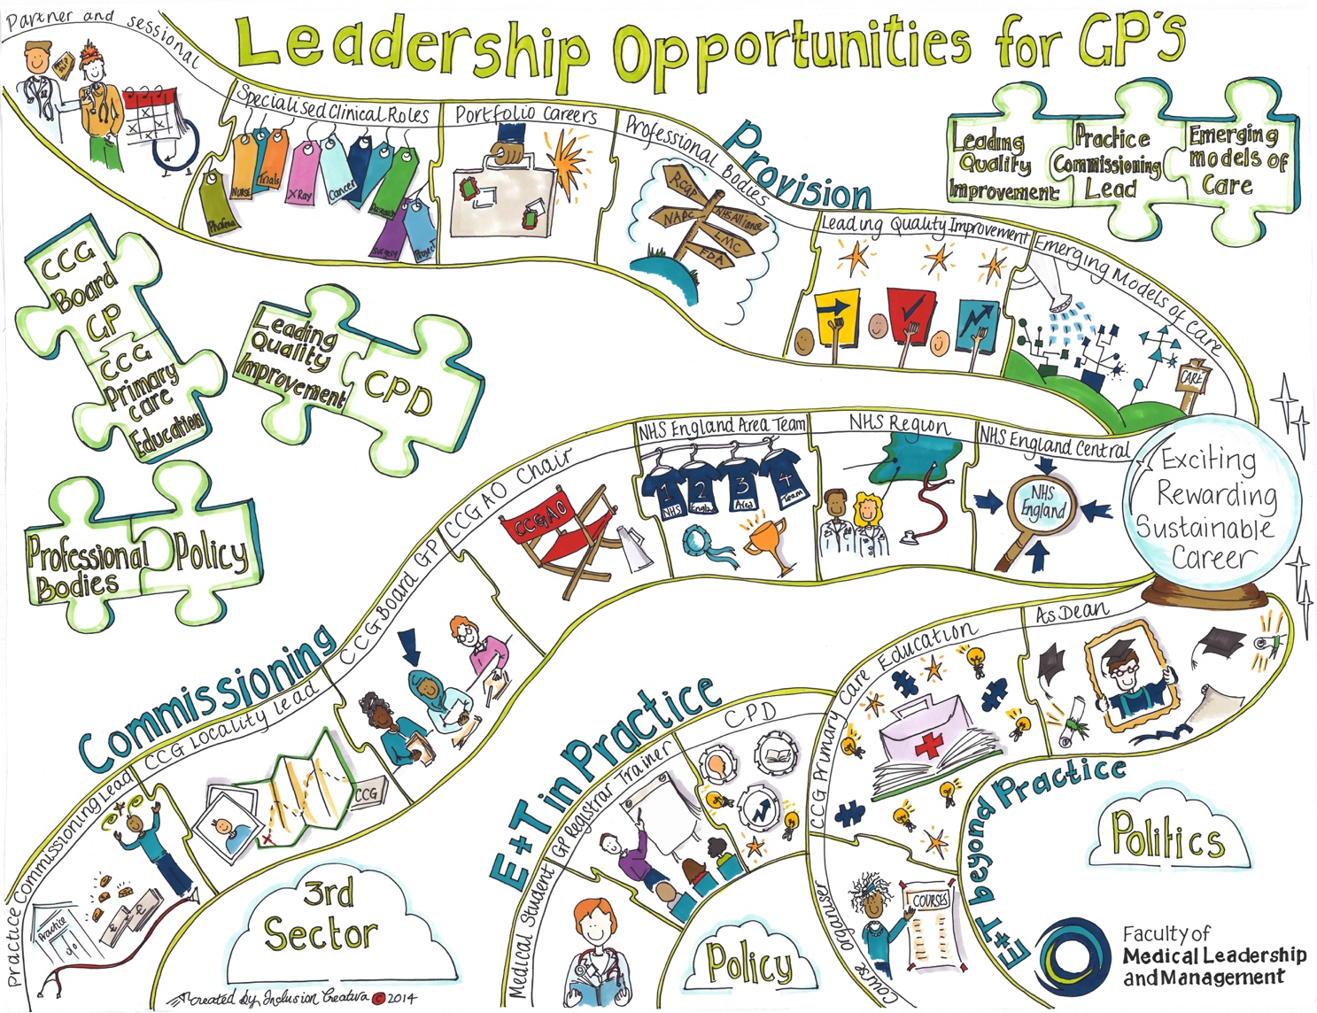
Notes:
We have worked with a range of stakeholders and members to evolve this map which starts to describe the range of opportunities available to GPs throughout their careers to enable them to have exciting, rewarding and sustainable careers. This was designed in 2014 and a number of bits of the map were missed, for example doctors in training and GPs working in providers other than primary care.
The jigsaw pieces represent that some work provides experience enabling GPs to explorer other roles, eg through doing a quality improvement audit in your practice you might be invited to do some work in your locality/cluster to spread good practice , part of which might be contributing to the local GP education programme.

Slide 8
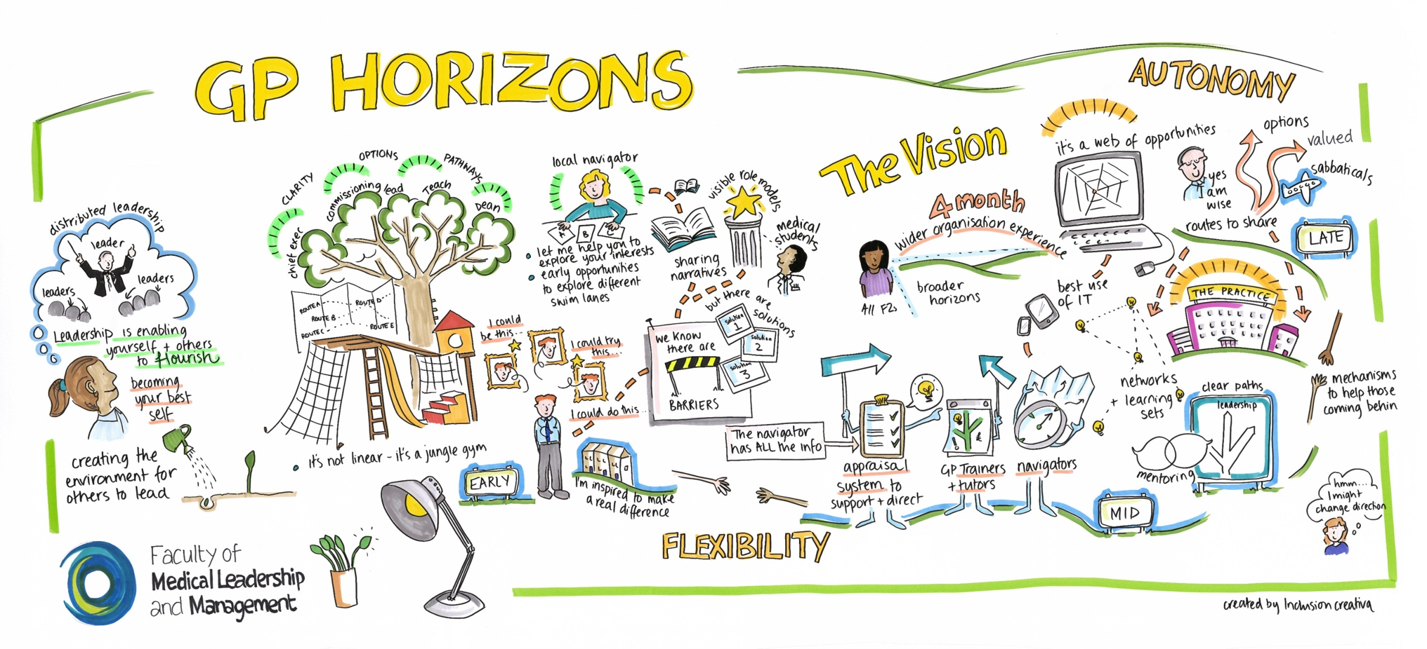
Notes:
In 2015 we had further collaborative events to shape our evolving GP career development framework – the participants chose to call it “GP Horizons”
This demonstrates:
On the far left- what we mean by leadership
To the right of that- the discussion about whether it should be a tree ( too hierarchical), climbing frame ( too rigid), snakes and ladders ( to negative) – so we alighted on it being more like a jungle gym.
There were similarities at all career stages with respect to what GPs wanted and needed , for example flexibility and autonomy when accessing leadership development. Coaching , mentoring and inspirational role models were valued by all.
In addition we explored what might be needed in particular early, mid and late career to fully explore the career map – towards an exciting, rewarding and sustainable career.

Slide 9
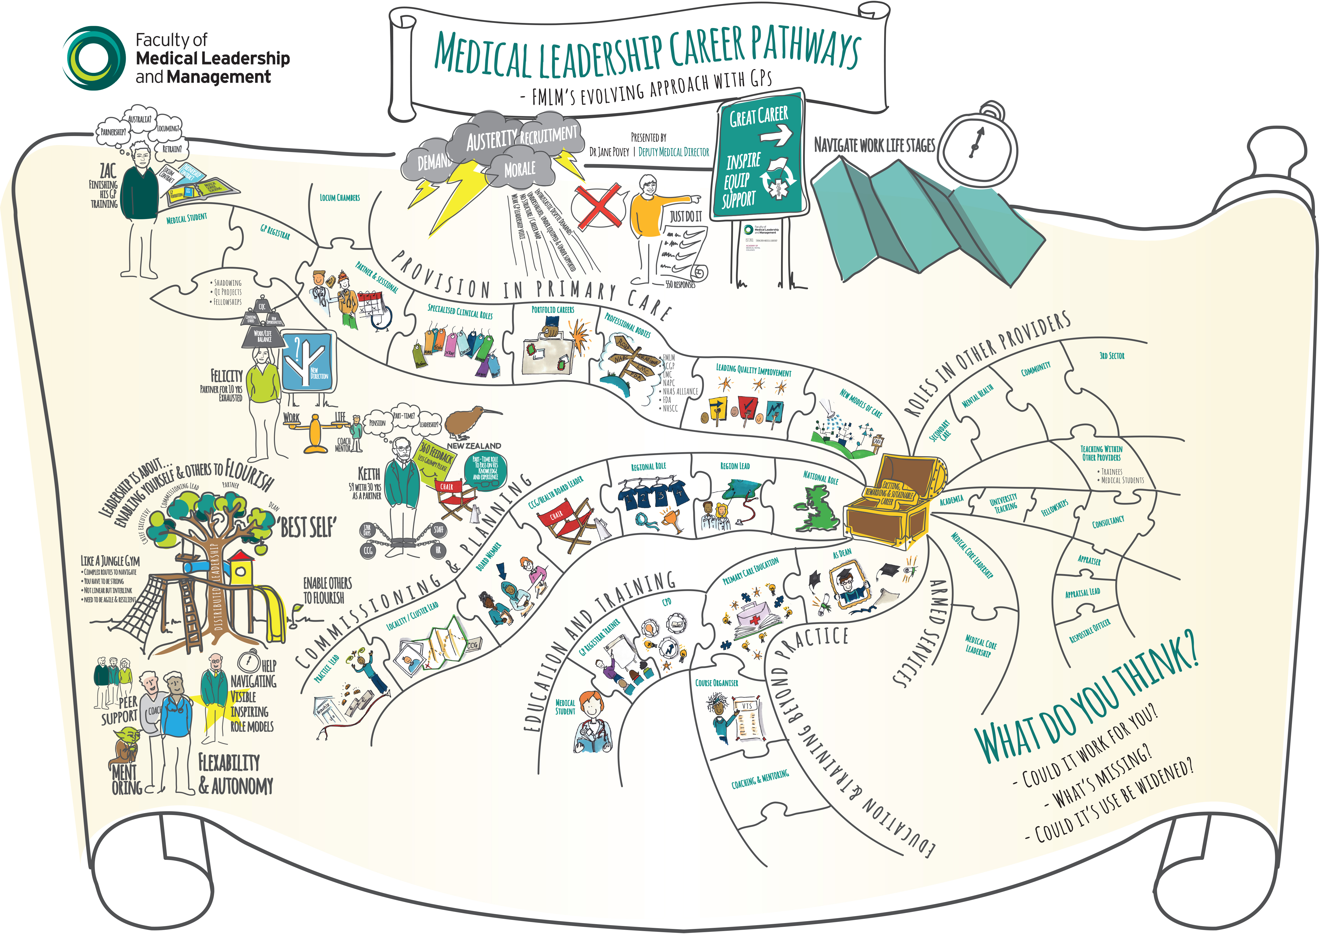
https://www.fmlm.ac.uk/resources/building-and-enabling-medical-leadership-career-pathways-–-the-story
Notes:
In 2016 we spent time evolving the map and framework, including some fictitious case studies, Zac, Felicity and Keith. This is best enjoyed via the Prezi – link here

Slide 10
Case studies
Notes:
At the request of GP Champions at our development session 1st March we plan to gather a range of case studies to share using a variety of media – perhaps you have some examples of doctors being great leaders and improvements made through medical leadership you could share in the meantime? If so do share them also with FMLM team and we will post on our website.

Slide 11

Local context
Notes:
If you would like to provide some local context about what is available with respect to leadership development and support

Slide 12
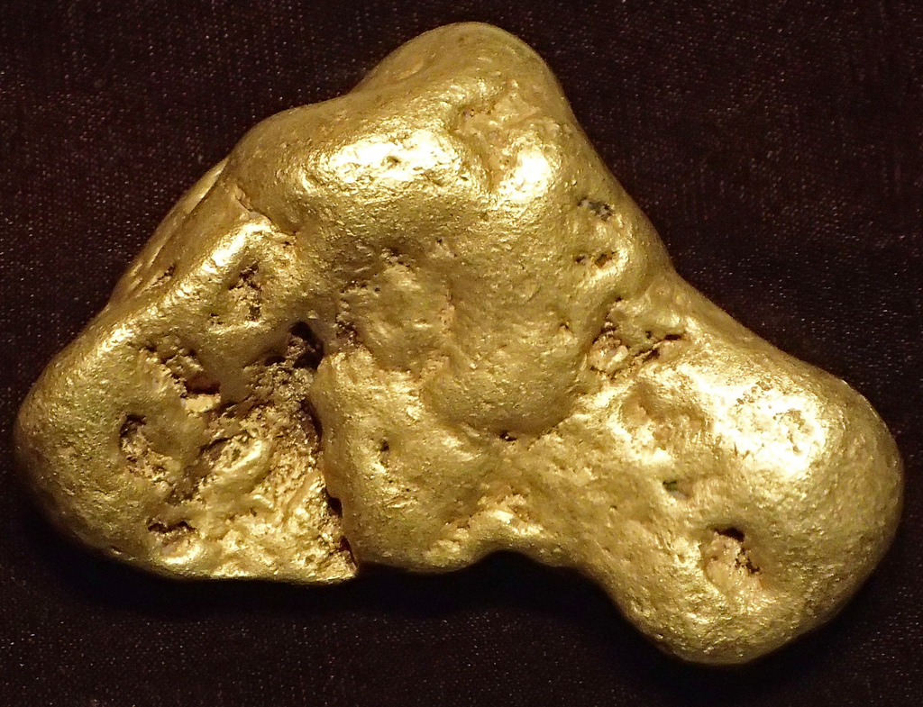
A practical “Nugget” for you
Notes:
What has made the most impact on you in your leadership journey so far?

Slide 13

Your ideas for FMLM?
Notes:
An opportunity to gather ideas/intelligence about what GPs around the UK would like of FMLM

Slide 14
“So the point is not to become a leader. The point is to become yourself, to use yourself completely — all your skills, gifts, and energies ... you must ... become the person you started out to be, and ... enjoy the process of becoming.”
Warren Bennis

